Slide 1
Making Arts Advocacy Work for You
Basic Knowledge and Application
"The arts are not partisan, they are not bipartisan, they are nonpartisan.”

Slide 2
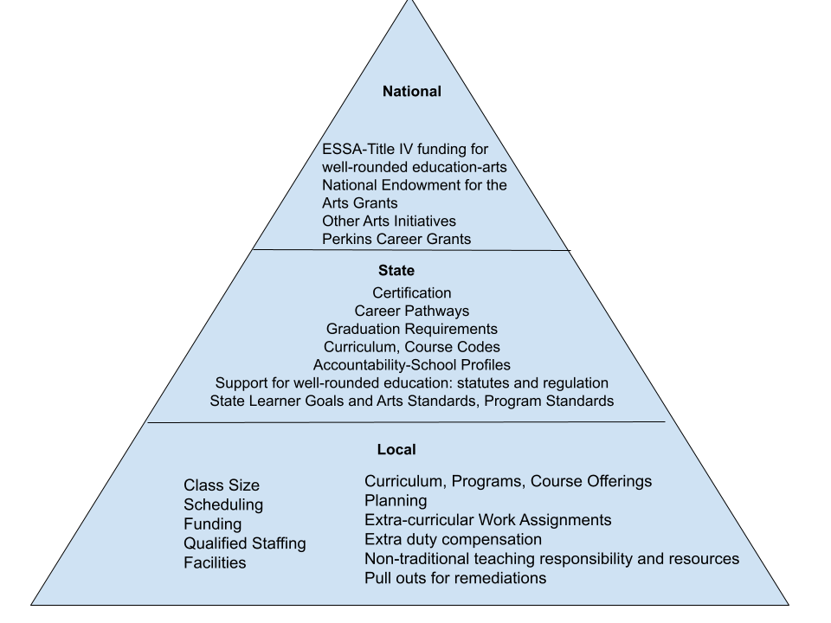
Education Issues That Often Require Advocacy
Notes:
Tanya - Issues Affecting Music Educators
Music Educators are impacted by multiple layers and levels of legislation, reglulation and policy.
Most of us realize that we have to be our own best advocate at the local level in terms of student access and instructional time, staffing, facilities, resources,
However, some of our local challenges and issues are not driven soley by local conditions. Often they are impacted by state and national laws, regulations, and policy.
At the state level learner goals, accountability systems, graduations requirements, and academic expectations are just a few examples of state initiated policy that can impact your local situation.
At the national level, reauthorizations of the Elementary and Secondary Education Act, currently the “Every Student Succeeds Act” drives state level assessment systems. Title IV of that act provides funding assistance for well-rounded education. National level grant such as the NEA grants and Perkins Career grants can all impact resources and direct focus to various initiatives at the state level.
Phil, tell us a little about national advocacy efforts focused on national policy. . . . . . . .

Slide 3
Arts Advocacy Occurs at Multiple Levels
National
State
Local

Slide 4
National Level Arts Advocacy
Purpose:
Broad advocacy and lobbying for all arts-- including arts education -- to influence national policy and support state and local efforts.
Support resources, research and data about the arts and arts education.
Guidance on national level legislation, programs, and opportunities.
Regular communications, newsletters, etc.
Events and communication to bring awareness to the importance of the arts.
Example Organizations:
Americans for the Arts (AFTA), Arts Education Partnership (AEP), State Arts Action Network (SAAN), National Association for Music Education (NAfME), National Art Education Association (NAEA), National Dance Education Organization, and Educational Theatre Association.
Notes:
Americans for the Arts advocates for financial support for arts, artists, education, and non-profits at the national level. They advocate for funding for the National Endowment for the Arts and National Endowment for the Humanities, as well as any legislations that impact the arts.

Slide 5
Support Resources/Guidance
Research and support data for the value of arts and arts education can be found at the NAfME and NAEA websites and at most other national arts education associations’ websites as well.
Arts Education Partnership which operates as a part of the Education Commission for the States. Membership is free – for updates get on the Commission email list.
National Endowment for the Arts is an independent federal agency providing funding and support for the arts.
National Assembly of State Arts Agencies is comprised of state arts agencies including the Kentucky Arts Council.
Arts Are Education is a new national campaign supporting arts education for all students.
Notes:
The above links take you to a wealth of different kinds of resources.
You may be familiar with NAfME – National Association for Musi Education, Arts Education Partnership - over 100 organizations dedicated to advancing arts education. Research - ArtsEdSearch. Arts Are Education is composed of all the national organizations including NAfME and provides an overview of current issues and tools to help, including a pledge that school boards can sign.

Slide 6
State Level Arts Advocacy
Purpose:
Influence state legislation, regulations, and policies and support state and local efforts. Includes broad arts perspective, arts education, specific art forms, arts organizations and practicing artists.
Provide resources that can be used to support state and local efforts and data to help inform state and local decisions.
Communicate and Network within the state to enhance the arts community.
Example Organizations:
Kentuckians for the Arts (KFTA), Kentucky Coalition for Arts Education (KCAE), Kentucky Music Educators Association (KMEA), Kentucky Art Education Association (KyAEA), Ky Theater Association (KTA), ShapeKY, Arts for All Kentucky (formerly VSA Kentucky), Kentucky Arts Council (KAC)

Slide 7
Local Level Arts Advocacy
Purpose:
Address the needs of the arts in local communities, schools/districts. Focus on local needs both large and small, across the arts, including individual art forms and programs, practicing artists, events, facilities, etc.
Support is specific to the need, whether organizational, program, or individual need.
Communicate and network within the community, across the state, and connect to resources at all levels.
Example Local Advocacy Needs:
Community arts providers such as theaters, arts venues, museums, school programs and teachers, individual practicing artists, support for specific school and community arts programs.
Notes:
At the local level, advocates may be focused on their own specific program, or the overall arts programs within a school system, an arts venue or individual work.
Advocates may be called upon to serve on boards or work with advocacy projects for various community arts initiatives. These might include community theater, bands, orchestras, choruses, performance facilities, fine arts series, and individual arts projects.
With many of these initiatives it will be important to communicate and network with community leaders and citizens in your area as well as draw on networking and resources across the state and at all levels.

Slide 8
Some Advocacy Needs
Specific to Arts Teachers
Class Size
Scheduling, credit requirements
Pull-outs for remediation
Funding
Qualified staffing, Teaching assignments
Facilities and Equipment
Curriculum, Programs, Course Offerings, Career Pathways
Planning time
Extra-curricular and Co-curricular Work Assignments
Extra-duty compensation
Non-traditional (NTI) teaching responsibility and resources
Notes:
Tanya -
As a music teacher, the issues you see here are often the most pressing, personal, immediate need. In these instances, you must develop some specific, proactive advocacy strategies which will ensure that your students can always expect the best from you and your program.
So, how can you be most effective with all levels of advocacy that most benefit you and the students you serve?
Jane is going to get us started with a strategic plan. Jane.

Slide 9
How to Be an Arts Advocate
1 – Be Informed
2 – Draw on and Share Collective Knowledge
3 – Create a Positive Team
4 – Connect With Your Legislators
5 – Be Actively Involved

Slide 10
1 - Be Informed
Develop a basic knowledge of national, state, and local resources for staying informed, and know who to go to for additional help.
Follow legislation, contact legislators, research statutes and regulations, and more at https://legislature.ky.gov/Pages/index.aspx
Track legislation and regulations that may impact your situation by joining Bill Watch and Reg Watch
https://kentucky.gov/services/pages/billwatch.aspx Bill Watch
https://secure.kentucky.gov/Regwatch/ Reg Watch
Sign up for Kentucky Teacher newsfeed at the KDE https://www.kentuckyteacher.org/
Follow facebook pages, communications from the state arts associations and advocacy groups. https://www.facebook.com/groups/kentuckyforart
Follow school site-based council minutes and board reports and media posts from your local system.
Notes:
KMEA, KCAE, and KFTA all follow bills and regulations that might affect you and will generally share information when there is a bill that needs arts advocacy. Follow their facebook and web pages.
But if you are interested and would like to stay personally informed follow the links shown in the slide for legislation information.
You can learn about how legislation is passed, find the drafts and amendments for all passed and current bils.
If you want to follow a specific bill, or be notified of bills on topics you are specifically interested you can sign up for bill watch at ky.gov. You can also sign up for reg watch at the same site to stay informed of any regulations being considered.
Kentucky Teacher is a direct newsfeed from the Department of Education. Getting on their newsfeed can sometimes provide you with a heads up on some issues.
At the local level, it’s really important to follow your site-based minutes and stay in touch with your reps as well as school system media posts and board meetings and minutes.

Slide 11
2 - Draw On and Share Collective Knowledge
Be an active member of organizations like arts education associations and Kentuckians for the Arts so that you can continually keep abreast of policy issues, successes, and models in the arts community, as well as strategies and techniques for improvement.
Kentuckians for the Arts
Contact: Phil Shepherd https://kfta.wildapricot.org/Contact
KFTA Facebook page https://www.facebook.com/groups/kentuckyforart
Kentucky Coalition for Arts Education
Contact: Jane Dewey jane.dewey37@gmail.com
Kentucky Music Educators Association
Contact: John Stroube john@kmea.org
Website: www.kmea.org
Kentucky Arts Council http://artscouncil.ky.gov/
Contact: Chris Cathers Christopher.Cathers@ky.gov
Samuel Lockridge Samuel.Lockridge@ky. gov

Slide 12
3 - Create a Positive Team Environment
Be a positive team player within your community. Work with peers and leaders to develop support and ensure them you have a broad view of the “big picture” in the arts community.
Publicize individual and group successes, events, and initiatives in the community.
Engage with community leaders, local news sources and social media to collaborate and share successes and promote your program.

Slide 13
Create a Positive Team (cont.)
Develop both group and one-on-one relationships in your community where you communicate the value of the arts to the community on a regular basis.
Educate your support groups!
At each arts event, take time to educate those in attendance about the value of the arts.
Take part in other arts and non-arts community organizations, churches, clubs, arts groups.
Do a great job in your work everyday, develop observable, positive results and nurture positive attitudes toward your program.

Slide 14
4 - Connect with Your Legislators
Build a relationship with your state legislators: Find out who your are at:
the Legislative Research Commission website.
Visit legislators’ web pages to get find out more about them and for additional contact information.
Let them know who you are and what your art form and work involve.
Share your public relations information (e.g., newsletter, website, etc.) with them.
Invite them to performances and exhibits, acknowledge them, have them speak, thank them for their support both personally and publicly.
Set up a meeting to talk with them if possible.

Slide 15
5 - Be Actively Involved
When you get Action Alerts and survey requests from advocacy and educational organizations, follow through.
Customize form letters to your situation.
Call the legislative message hotline (1-800-372-7181) and leave a message for specific legislators stating your position; it is often more quickly effective than email.
Keep communication short, respectful, nonpartisan, and to the point.
Provide data to support your view and a story they can recall. (Don’t provide data without a story and don’t provide a story without data).

Slide 16
For more information visit the Kentuckians for the Arts website:
https://kfta.wildapricot.org
Remember that the arts are not partisan, they are not bipartisan, they are nonpartisan

